Slide 1

Green Pace
Security Policy Presentation
Developer: Kentrell Edwards

Slide 2

OVERVIEW: DEFENSE IN DEPTH
The Green Pace Software Development Security Policy is a crucial framework designed to consistently incorporate security principles into all software development activities. In response to the evolving landscape of cybersecurity threats, this policy defines core security principles, coding standards, access controls, and data encryption standards, while also ensuring the uniform application of these security measures. By extending its scope to all staff involved in software development, it aligns with the defense-in-depth best practice, emphasizing the importance of multiple security layers.

Slide 3
THREATS MATRIX
The Threats Matrix is a tool to identify and prioritize potential security threats and associate them with the relevant coding standards and policies that address those threats.
Likely Weak Encryption Unauthorized Access Cross-Site Scripting(XSS) | Priority SQL Injection Code Injection Unvalidated Redirects
Low priority Data Type Inconsistency Password Cracking Handle All Exceptions | Unlikely Insufficient Logging Lack of Authentication Floats in loop Counters

Slide 4
10 PRINCIPLES
Principle 1: Validate Input Data
Coding Standards: 4 (Sanitize Data Sent to Other Systems), 10 (Adopt a Secure Coding Standard)
Principle 2: Heed Compiler Warnings
Coding Standards: 2 (Data Value), 6 (Assertions)
Principle 3: Architect and Design for Security Policies
Coding Standards: 3 (String Correctness), 8 (Use Effective Quality Assurance Techniques
Principle 4: Keep It Simple
Coding Standards: 5 (Default Deny), 9 (Input Validation)
Principle 5: Default Deny
Coding Standards: 5 (Default Deny), 7 (Exceptions)
Principle 6: Adhere to the Principle of Least Privilege
Coding Standards: 4 (Sanitize Data Sent to Other Systems), 9 (Input Validation)
Principle 7: Sanitize Data Sent to Other Systems
Coding Standards: 1 (Data Type), 6 (Assertions)
Principle 8: Practice Defense in Depth
Coding Standards: 3 (String Correctness), 7 (Exceptions)
Principle 9: Use Effective Quality Assurance Techniques
Coding Standards: 8 (Use Effective Quality Assurance Techniques), 10 (Adopt a Secure Coding Standard)
Principle 10: Adopt a Secure Coding Standard
Coding Standards: 2 (Data Value), 10 (Adopt a Secure Coding Standard)

Slide 5
CODING STANDARDS
Data Type Consistency
Ensure consistent use of data types across the application.
Data Value Validation
Validate all user input and data values for correctness and adherence to expected ranges.
String Correctness
Ensure correct handling of strings to prevent issues like buffer overflows and format string vulnerabilities.
SQL Injection Prevention
Sanitize and validate input data to prevent SQL injection attacks.
Memory Protection
Implement memory protection mechanisms like ASLR and DEP to prevent memory-based attacks.
6. Assertions and Error Handling
Use assertions and proper error handling to catch and report exceptional conditions.
7. Exception Handling
Implement robust exception handling to prevent information leakage and maintain system integrity.
8. Input Validation
Thoroughly validate and sanitize input data to prevent injection attacks and data corruption.
9. Authentication and Authorization
Implement strong authentication and authorization mechanisms to control access to resources.
10. Encryption
Implement encryption mechanisms to protect data in transit, at rest, and in use.

Slide 6
ENCRYPTION POLICIES
Encryption in Flight: This policy ensures that all data transferred over networks, whether within the organization or externally, is encrypted using robust protocols such as TLS/SSL. It prioritizes data confidentiality and integrity during transmission, protecting it from eavesdropping and man-in-the-middle attacks.
Encryption at Rest: This policy mandates the encryption of sensitive and critical data when it's stored on physical or digital media. It requires strong encryption algorithms and secure key management to protect data at rest, mitigating risks associated with unauthorized access to storage media.
Encryption in Use: Focusing on data protection during active processing, this policy requires the implementation of encryption mechanisms within applications and during data processing operations. It ensures data confidentiality and guards against insider threats and unauthorized access during data processing.

Slide 7
TRIPLE-A POLICIES
Authentication Policy: This policy focuses on verifying the identity of users and systems. It mandates strong authentication methods, secure credential storage, and the use of multi-factor authentication (MFA). Access to systems is granted only after valid user authentication, ensuring secure and controlled entry.
Authorization Policy: The authorization policy governs what authenticated users or systems can do. It employs role-based access control (RBAC) to assign permissions based on user roles. Access control lists (ACLs) and policies restrict access to resources, following the principle of least privilege to minimize access to what's necessary.
Accounting Policy: This policy revolves around tracking and monitoring activities. It enforces comprehensive logging and auditing, securely storing logs and regularly reviewing audit trails. It supports the generation of reports and alerts based on accounting data for incident response and compliance.

Slide 8
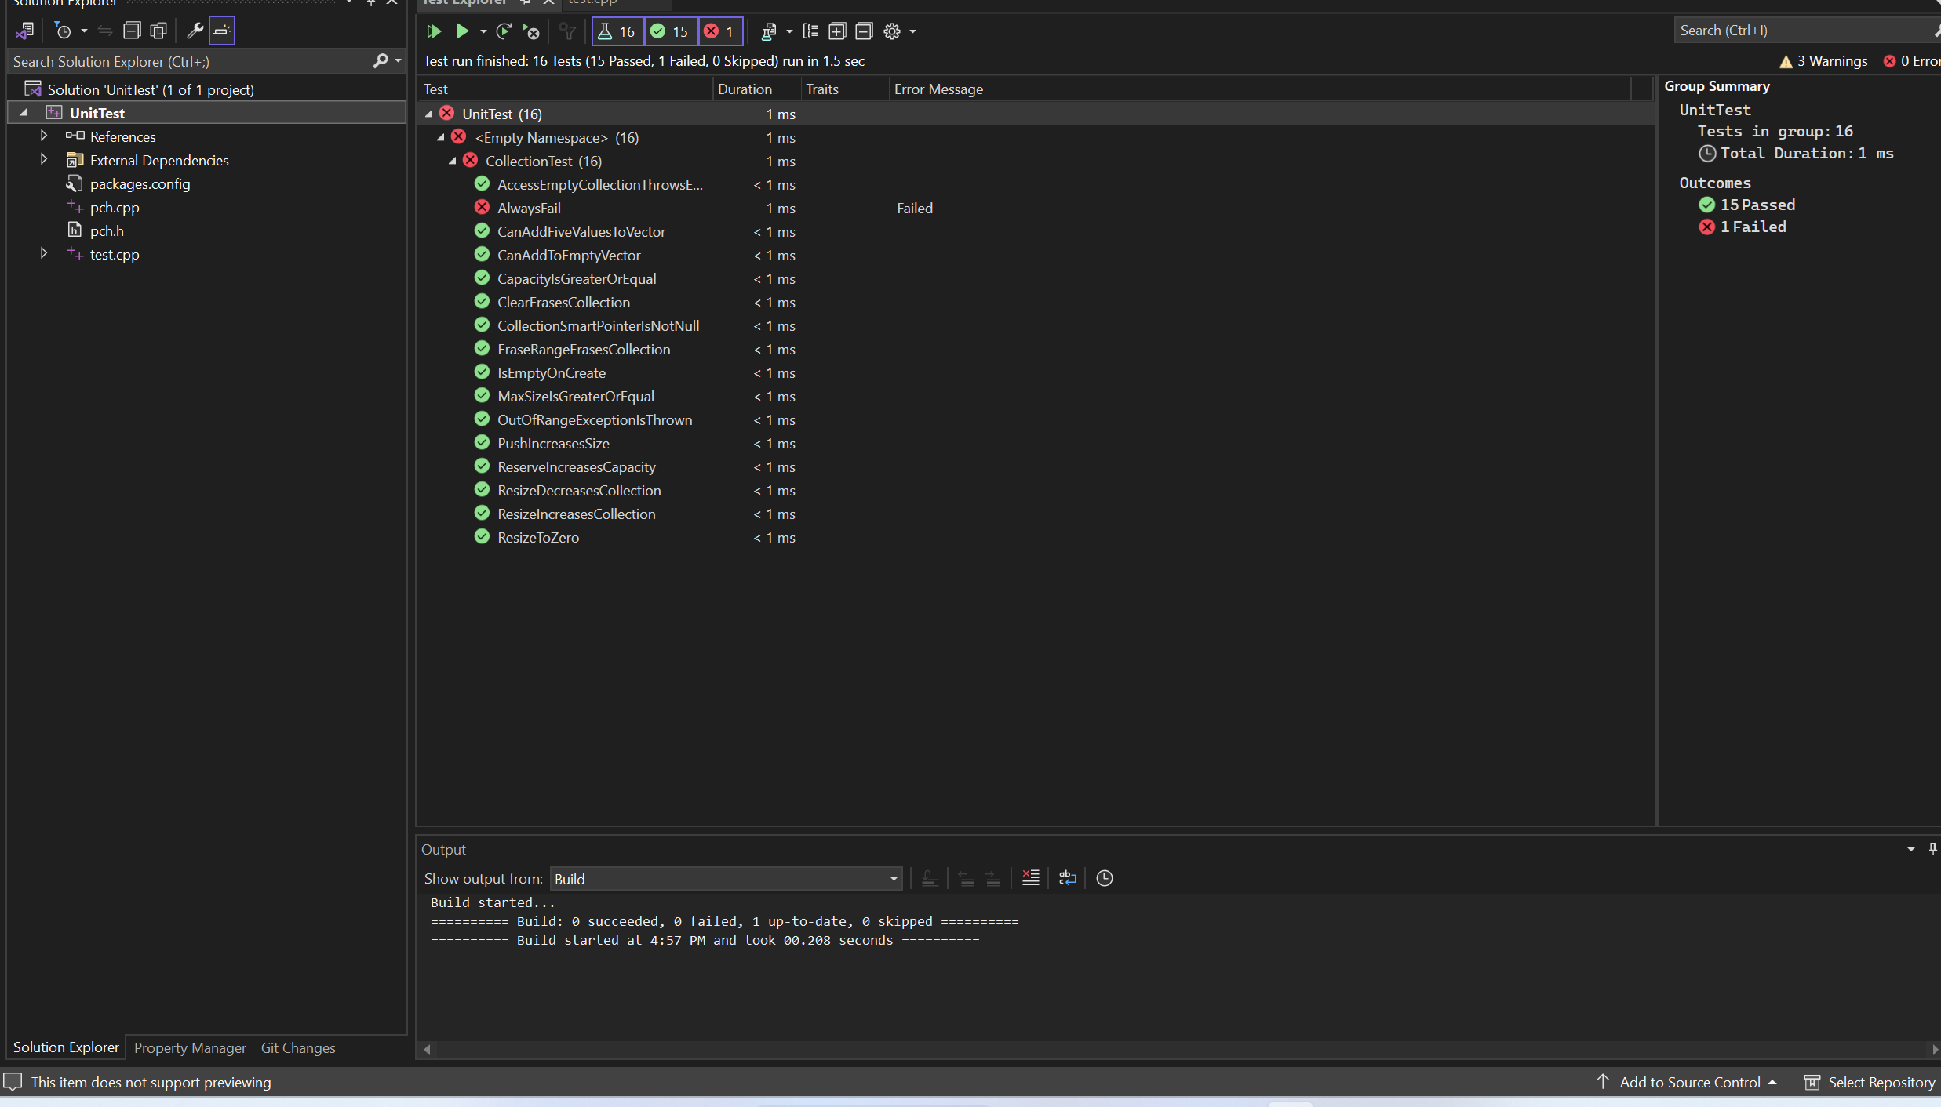
Unit Testing
The provided unit tests meticulously validate the C/C++ code using Google Test's ASSERT and EXPECT functionality, ensuring thorough verification of specific conditions. The code follows industry-standard best practices with clear comments, meaningful naming, and a structured design pattern approach. The debugging process was comprehensive, addressing various types of bugs and confirming that the unit tests accurately represent the intended code behavior.

Slide 9
Unit Testing ClearErasesCollection
// TODO: Create a test to verify clear erases the collection TEST_F(CollectionTest, ClearErasesCollection) { // Add some entries add_entries(5); // Clear the collection collection->clear(); // Check if the size is now zero ASSERT_EQ(collection->size(), 0); }

Slide 10
Unit Testing IsEmptyOnCreate
// Test that a collection is empty when created. TEST_F(CollectionTest, IsEmptyOnCreate) { // is the collection empty? ASSERT_TRUE(collection->empty()); // if empty, the size must be 0 ASSERT_EQ(collection->size(), 0); }

Slide 11
Unit Testing MaxSizeIsGreaterOrEqual
// Test that max size is greater than or equal to size for 0, 1, 5, 10 entries TEST_F(CollectionTest, MaxSizeIsGreaterOrEqual) { // Test for size 0 ASSERT_GE(collection->max_size(), 0); // Add a single entry and test again collection->push_back(1); ASSERT_GE(collection->max_size(), 1); // Add more entries and test for size 5 add_entries(4); ASSERT_GE(collection->max_size(), 5); // Add more entries and test for size 10 add_entries(5); ASSERT_GE(collection->max_size(), 10); }

Slide 12
Unit Testing AlwaysFail
/* Comment this test out to prevent the test from running * Uncomment this test to see a failure in the test explorer */ TEST_F(CollectionTest, AlwaysFail) { FAIL(); }

Slide 13

AUTOMATION SUMMARY

Slide 14
TOOLS
The DevSecOps pipeline is an integrated and automated software development and deployment process that embeds security practices throughout the entire lifecycle to ensure secure, reliable, and rapid delivery of software.
In the DevSecOps diagram, various security tools are strategically integrated into the flow of automation to enhance the security and reliability of the software development and deployment process. These tools are primarily employed at the following stages:
Static Analysis (Static Testing): Tools like SonarQube are utilized during the static analysis stage to scan the source code for vulnerabilities, coding errors, and adherence to coding standards. This stage ensures that code quality and security are addressed at the early development phase.
Vulnerability Scanning (Containerization): Clair, an external tool, is integrated into the containerization and vulnerability scanning stage. It scans container images for known vulnerabilities, enhancing the security of containerized applications.
Continuous Monitoring & Alerting (Runtime): Prometheus is incorporated into the monitoring and logging stage during the runtime phase. It continuously monitors application performance and triggers alerts in case of anomalies, ensuring real-time insights and proactive issue detection and resolution.
Incident Response (Post-Deployment): While not explicitly mentioned in the diagram, the incident response tools and processes come into play as part of the security measures. They are activated after deployment to address and mitigate security incidents promptly.

Slide 15
RISKS AND BENEFITS
Problem: Delaying action may lead to an increased vulnerability to security threats and a potential negative impact on customer trust.
Problem: The strategy may lack scalability for future growth.
Solution: Acting now will improve security and ensure customer data protection.
Solution: Immediate action can enhance the organization's compliance with security standards and regulations.
Solution: Addressing scalability concerns in advance is essential for accommodating future growth.
Benefits (Acting Now):
Benefit: Improved security posture, reduced vulnerabilities, and enhanced customer trust.
Benefit: Compliance with security standards ensures legal and regulatory requirements are met.
Benefit: Proactive scalability planning enables smooth growth transitions.
Risks (Delaying Action):
Risk: Delaying security improvements increases the risk of security breaches and potential data loss.
Risk: Non-compliance with regulations may result in legal consequences and penalties.
Risk: Lack of scalability planning could hinder the organization's ability to meet future demands.

Slide 16
RECOMMENDATIONS
Gap Analysis of Existing Security Policy:
The existing security policy is robust and comprehensive, but there are several areas where it can be further enhanced:
Incident Response Plan: The policy lacks a detailed incident response plan. While it outlines preventive measures, it should include a step-by-step guide for responding to security incidents. For example, in 2020, SolarWinds faced a massive cybersecurity incident that could have been mitigated more effectively with a well-defined incident response plan.
Security Awareness Training: While the policy mentions security awareness, it could be more specific about training requirements. Employee training is crucial for reducing security risks, as highlighted by the Verizon Data Breach Investigations Report, which notes that human errors are a leading cause of data breaches.
Third-Party Risk Management: The policy does not provide comprehensive guidance on managing security risks associated with third-party vendors. A notable example is the Target data breach in 2013, which occurred due to a vulnerability in a third-party vendor's system.

Slide 17
CONCLUSIONS
Future Potential Gaps and Improvements:
To address these gaps and prevent future problems, the following standards and practices should be adopted:
Incident Response Plan: Develop and implement a detailed incident response plan that outlines roles, responsibilities, and actions to be taken during a security incident. This plan should align with industry standards like NIST SP 800-61.
Security Awareness Training: Enhance the policy by specifying mandatory security awareness training for all employees. The SANS Institute's "Securing The Human" program is an example of effective security awareness training.
Third-Party Risk Management: Implement a comprehensive third-party risk management program that assesses, monitors, and manages security risks associated with vendors. Standards such as ISO 27001 can provide a framework for this.
Regulatory Compliance: Keep the policy up-to-date with relevant legal and regulatory standards, such as GDPR, HIPAA, or PCI DSS, as they evolve. Compliance with these standards is essential to prevent legal and reputational problems.

Slide 18
REFERENCES
Hardy, M. (2014). Target Store Data Breaches: Examination and Insight. Nova Science Publishers, Inc.
Jaeger, J. (2017, July). Data breach trends industry by industry: The 2017 Verizon Data Breach report is out, and it has some timely pointers for how healthcare, financial services, manufacturing, and retail organizations can improve their cyber-security. Jaclyn Jaeger has more. Compliance Week, 14(162), 42+. https://link-gale-com.ezproxy.snhu.edu/apps/doc/A535032329/GBIB?u=nhc_main&sid=ebsco&xid=db6ec47e
Mar, S. (2021, June 1). THE AFTERMATH OF SOLARWINDS: The massive cybersecurity breach raises questions about infrastructure and network risks that internal audit can help answer. Internal Auditor, 78(3).
Seacord, R. C. (2013). Secure Coding in C and C++ (2nd ed.). Pearson Technology Group. https://mbsdirect.vitalsource.com/books/9780132981972

